Slide 1


PSYLIQ Internship Project
HR DATA ANALYSIS
Using MS Excel and Power BI
Shravan Birajdar
www.linkedin.com/in/shravan-ramesh-birajdar-28a58b137

Slide 2


Agenda
Introduction
Project Questions
Solutions
Dashboard and Insights
Summery

Slide 3
INTRODUCTION
Embarking on a data-driven journey, I've meticulously dissected a dataset using the dynamic duo of Microsoft Excel and Power BI.
Unveiling hidden patterns and trends, this analysis showcases the synergy between Excel's versatility and Power BI's robust visualization capabilities. From meticulous data cleaning to insightful visualizations, join me in unraveling the compelling story woven into this dataset through the lens of Excel and Power BI.

Slide 4

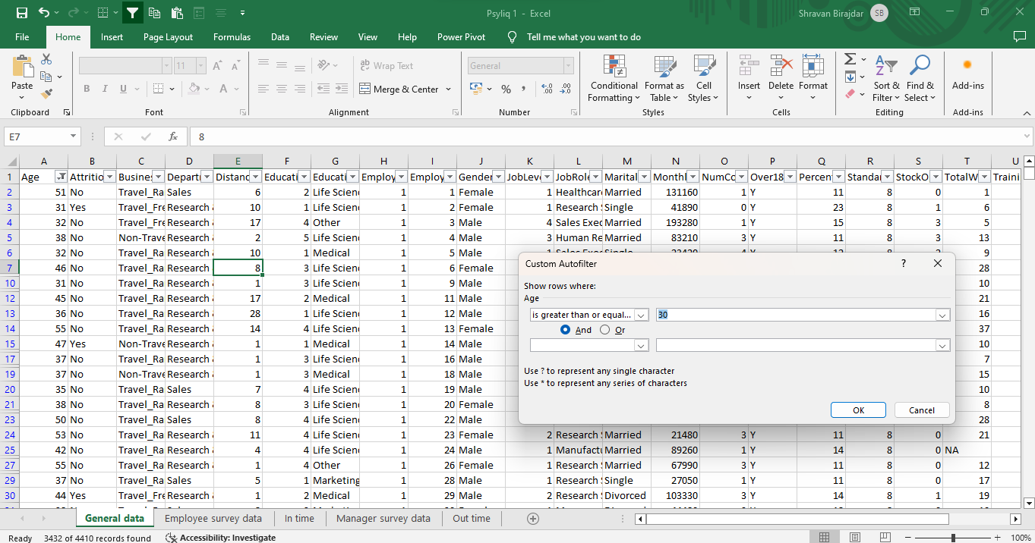
HR DATA ASSESSMENT
Using Excel, how would you filter the dataset to only show employees aged 30 and above?

Slide 5
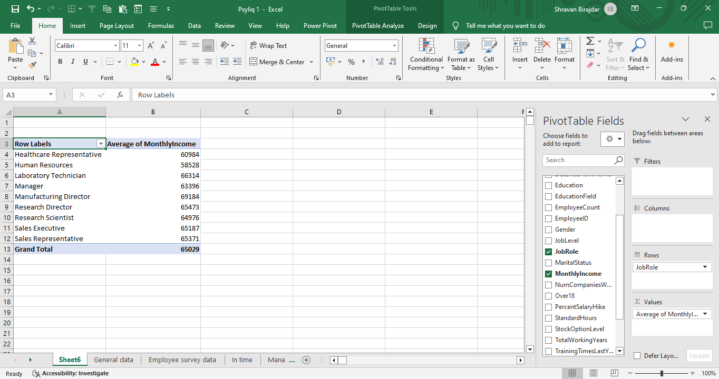
HR DATA ASSESSMENT
Create a pivot table to summarize the average Monthly Income by Job Role.

Slide 6
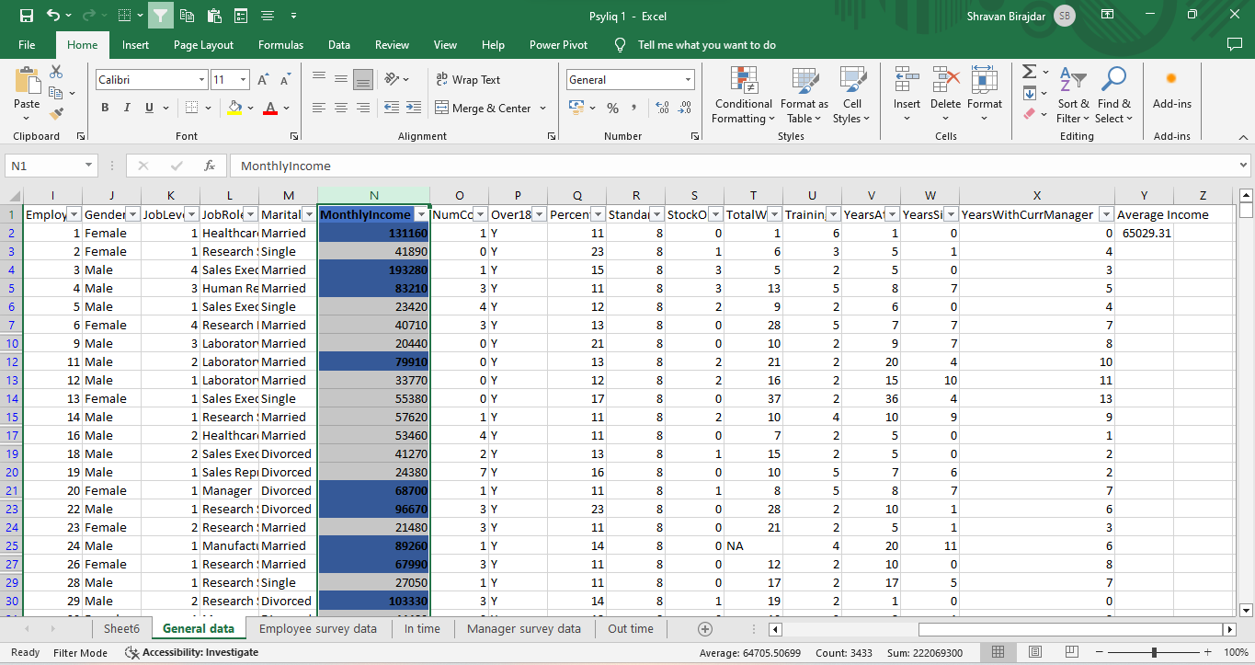
HR DATA ASSESSMENT
Apply conditional formatting to highlight employees with Monthly Income above the company's average income.

Slide 7
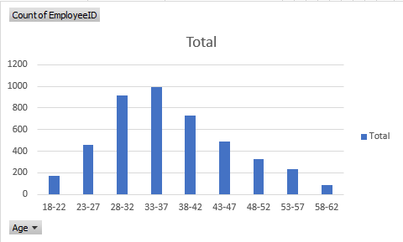
HR DATA ASSESSMENT
Create a bar chart in Excel to visualize the distribution of employee ages.

Slide 8
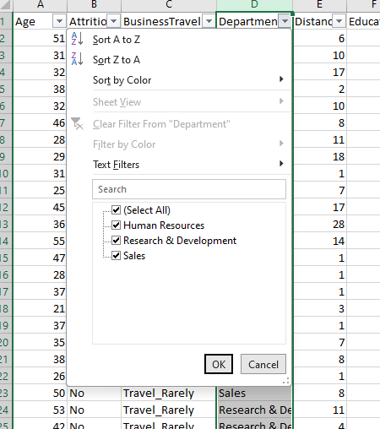
HR DATA ASSESSMENT
Identify and clean any missing or inconsistent data in the "Department" column.
No Inconsistent Data found in the Department column.

Slide 9
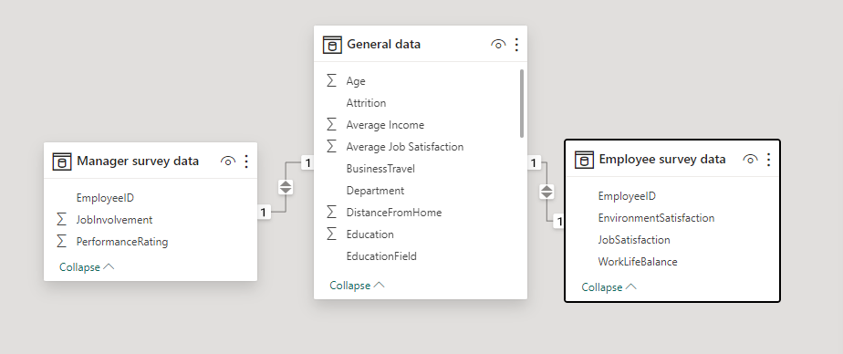
HR DATA ASSESSMENT
In Power BI, establish a relationship between the “EmployeeID” in the employee data and the “EmployeeID” in the time tracking data.

Slide 10
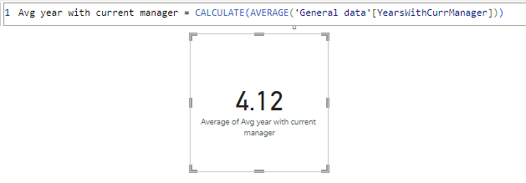
HR DATA ASSESSMENT
Using DAX, create a calculated column that calculates the average years an employee has spent with their current manager.

Slide 11
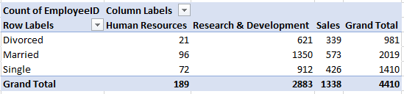
HR DATA ASSESSMENT
Using Excel, create a pivot table that displays the count of employees in each Marital Status category, segmented by Department.

Slide 12
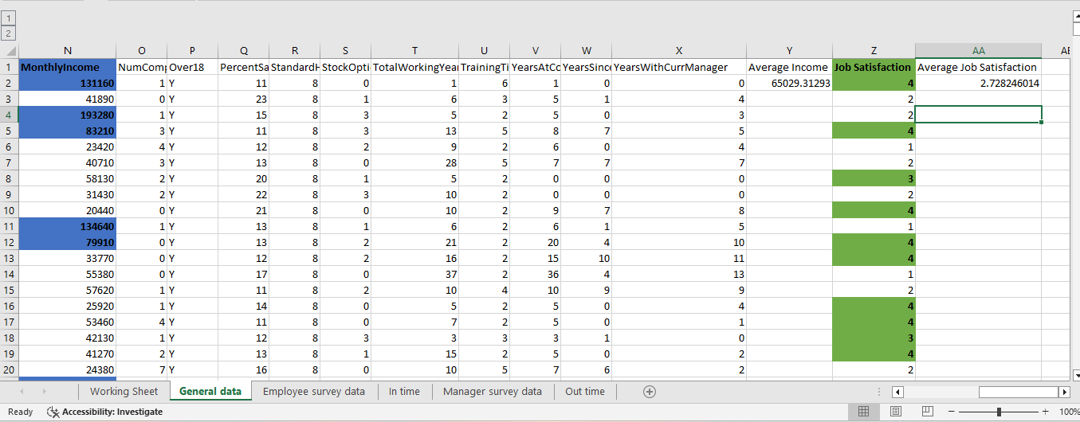
HR DATA ASSESSMENT
Apply conditional formatting to highlight employees with both above-average Monthly Income and above-average Job Satisfaction.

Slide 13
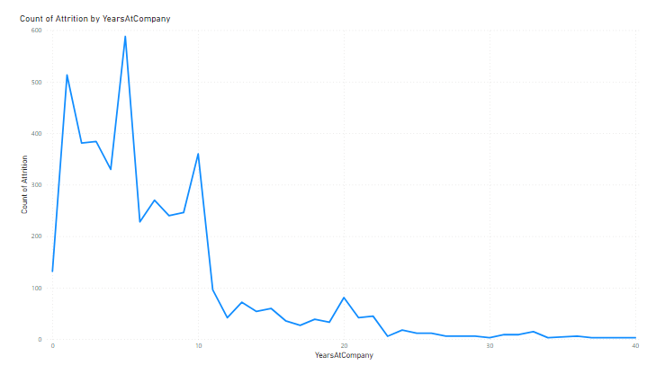
HR DATA ASSESSMENT
In Power BI, create a line chart that visualizes the trend of Employee Attrition over the years.

Slide 14
HR DATA ASSESSMENT
Describe how you would create a star schema for this dataset, explaining the benefits of doing so
We can use Power BI data modelling to create star schema. It involves structuring it into a central fact table and related dimension tables. The primary key is Employee ID.
Fact Table: The central fact table is general_data.
Dimension Tables: Employee_survey_data, manager_survey_data, in_time, out_time.
Benefits of Star Schema:
• Performance Improvement: Optimizes query performance by minimizing redundant data.
• Ease of Maintenance: Simplifies updates as changes are confined to dimension tables.
• Enhanced Query Clarity: Facilitates clearer, more straightforward queries due to well-defined relationships.
• Scalability: Provides scalability as additional dimensions can be easily incorporated.

Slide 15
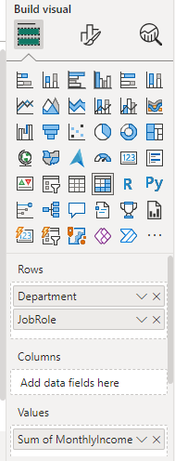
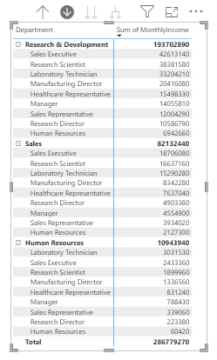
HR DATA ASSESSMENT
Create a hierarchy in Power BI that allows users to drill down from Department to Job Role to further narrow their analysis.
Step 1: We use hierarchy in Power BI using MATRIX. First Select a Matrix.
Step 2: Dragged and dropped Department and JobRole into rows section and MonthlyIncome in values section.
Step 3: Use the + icon in the matrix view to see the hierarchy.

Slide 16
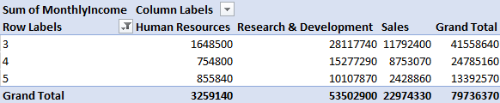
HR DATA ASSESSMENT
In Excel, calculate the total Monthly Income for each Department, considering only the employees with a Job Level greater than or equal to 3.

Slide 17
HR DATA ASSESSMENT
Verify if the data adheres to a predefined schema. What actions would you take if you find inconsistencies?
If the data adheres to a predefined schema and if we found any inconsistencies in the data, the following actions can be performed to address the inconsistencies.
Review the predefined schema or data model to understand the structure, format, data types etc and compare that data against predefined schema to identify inconsistencies such as incorrect data types, missing values/blank values, wrong data entry etc.
Perform data cleaning activity to rectify inconsistencies such as entering the valid data in place of missing values and correction in data types, removing duplicate data etc.
Set up validation rules to prevent future inconsistencies. This ensures that the new data entering the system confirms to the defined schema.
Consider automating the data validation process, this could involve setting up scripts that run at regular intervals or triggering validation checks as part of a data ingestion pipeline.
Finally, keep monitoring the data for new inconsistencies, particularly if the data source is dynamic or if the schema is updated over time. Regular audits can help maintain data integrity.

Slide 18
PROJECT ANALYSIS INSIGHTS
Data Overview: In Our workforce, there are 2,646 males and 1,764 females contributing to a total monthly income of $286,779,270. The average monthly income for employees is a noteworthy $65,029.
Workforce Statistics: The workforce experiences an average attrition rate of 16.1% coupled with an average salary hike of 15.21%. Moreover, majority of employees needs to travel rarely.
Departmental Distribution: There are 3 departments named R&D, Sales and HR with almost 65% of employees belonging to R&D
Employee Insights: The average job satisfaction score stands at 2.72 on a scale of 4. Employees rate their work-life balance at 2.8 on a scale of 4.
Marital Status: 46% of the workforce are married, 32% single and 22% divorced.
Managerial Insights: Managers exhibits an overall job involvement of 2.72% and their performance is reflected in an average rating of 3.15.

Slide 19
SUMMERY
The dataset includes information about employees, covering factors like age, attrition, business travel, department, distance from home, education, gender, job level, job role, marital status, monthly income, and various other attributes.
The analysis focus on trends, patterns, and insights related to employee demographics, job characteristics, and factors that might influence attrition. It's essential to explore relationships between different variables, identify key metrics, and derive actionable insights for optimizing employee satisfaction and retention.
The findings can inform strategic decisions and human resource management practices within the organization.

Slide 20
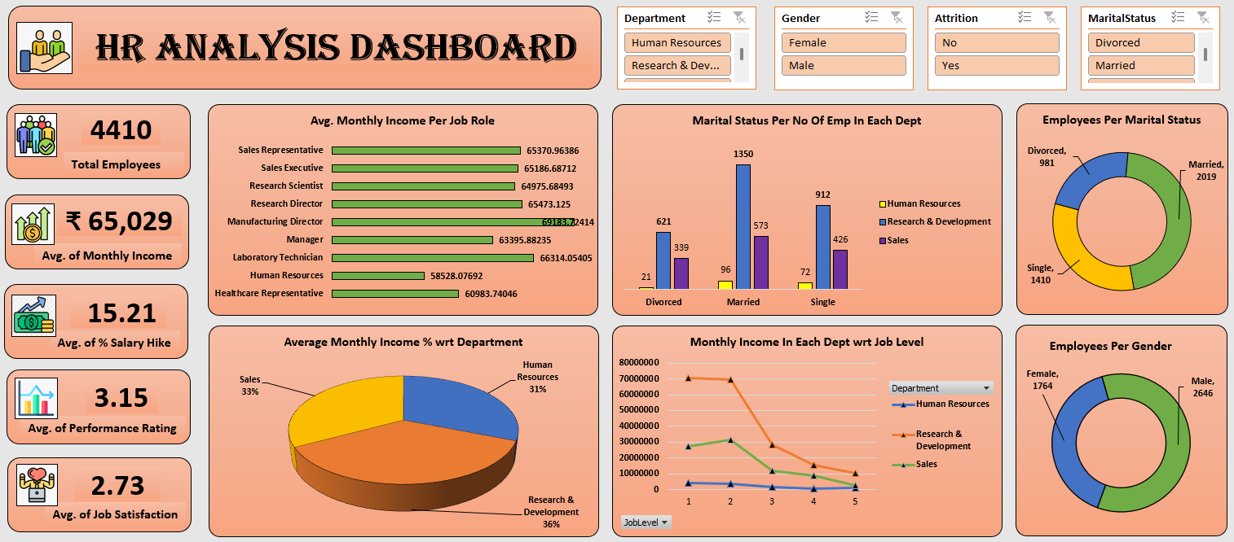
ANALYSIS DASHBOARD

Slide 21
Thank You…
Shravan Birajdar Data Analyst Intern at PSYLIQ

